Slide 2
Notes:
NYSHealth data snapshot: https://nyshealthfoundation.org/resource/health-care-spending-trends-in-new-york-state/
1 National Center for Health Statistics, Center for Disease Control, “Health Insurance Coverage: Early Release of Estimates From the National Health Interview Survey, January-September 2016,” Table XVI. https://
www.cdc.gov/nchs/data/nhis/earlyrelease/insur201702.pdf, accessed February 2018.
2 U.S. Census Bureau. Table HIC-4 _ ACS. Health Insurance Coverage Status and Type of Coverage by State All People: 2008 to 2016. Retrieved from: https://www.census.gov/library/publications/2017/demo/p60-
260.html
3 U.S. Census Bureau, “Historical Income Tables - Households” Table H-8, https://www.census.gov/data/tables/time-series/demo/income-poverty/historical-income-households.html, accessed December 2017.
4 Agency for Healthcare Research and Quality, MEPS-IC State Tables in Spreadsheet Format by State. https://meps.ahrq.gov/mepsweb/data _ stats/state _ tables.jsp?regionid=26&year=-1
5 America’s Health Insurance Plans, “2016 Survey of Health Savings Account – High Deductible Health Plans,” https://www.ahip.org/wp-content/uploads/2017/02/2016 _ HSASurvey _ Draft _ 2.14.17.pdf, accessed
December 2017; America’s Health Insurance Plans, “2015 Census of Health Savings Account - High Deductible Health Plans” https://www.ahip.org/wp-content/uploads/

Slide 4
Notes:
Source: Agency for Healthcare Research and Quality, Medical Expenditure Panel Survey-Insurance Component, private-sector establishments, Table I.D.1, 2008-2016.
National-level Data: https://meps.ahrq.gov/mepsweb/data _ stats/quick _ tables _ results.jsp?component=2&subcomponent=1&year=-1&tableSeries=1&tableSubSeries=CDE&searchText=&s
earchMethod=1&Action=Search;
State-level Data: MEPS-IC State Tables in Spreadsheet Format by State, Table II.D.1, 2008-2016. https://meps.ahrq.gov/mepsweb/data _ stats/state _ tables.jsp?regionid=26&year=-1

Slide 5
Notes:
Source: Agency for Healthcare Research and Quality, Medical Expenditure Panel Survey, Table II.D.1, 2016. https://meps.ahrq.gov/data _ stats/summ _ tables/insr/state/series _ 2/2016/tiid1.pdf

Slide 6
Notes:
Source: Agency for Healthcare Research and Quality, Medical Expenditure Panel Survey-Insurance Component, private-sector establishments, Table I.C.1, 2008-2016.
National-level Data: https://meps.ahrq.gov/mepsweb/data _ stats/quick _ tables _ results.jsp?component=2&subcomponent=1&year=-1&tableSeries=1&tableSubSeries=CDE&searchText=&s
earchMethod=1&Action=Search;
State-level Data: MEPS-IC State Tables in Spreadsheet Format by State, Table II.C.1, 2008-2016. https://meps.ahrq.gov/mepsweb/data _ stats/state _ tables.jsp?regionid=26&year=-1

Slide 7
Notes:
Source: Agency for Healthcare Research & Quality, Medical Expenditure Panel Survey, Table II.C.1, 2016. https://meps.ahrq.gov/data _ stats/summ _ tables/insr/state/series _ 2/2016/tiic1.pdf.

Slide 8
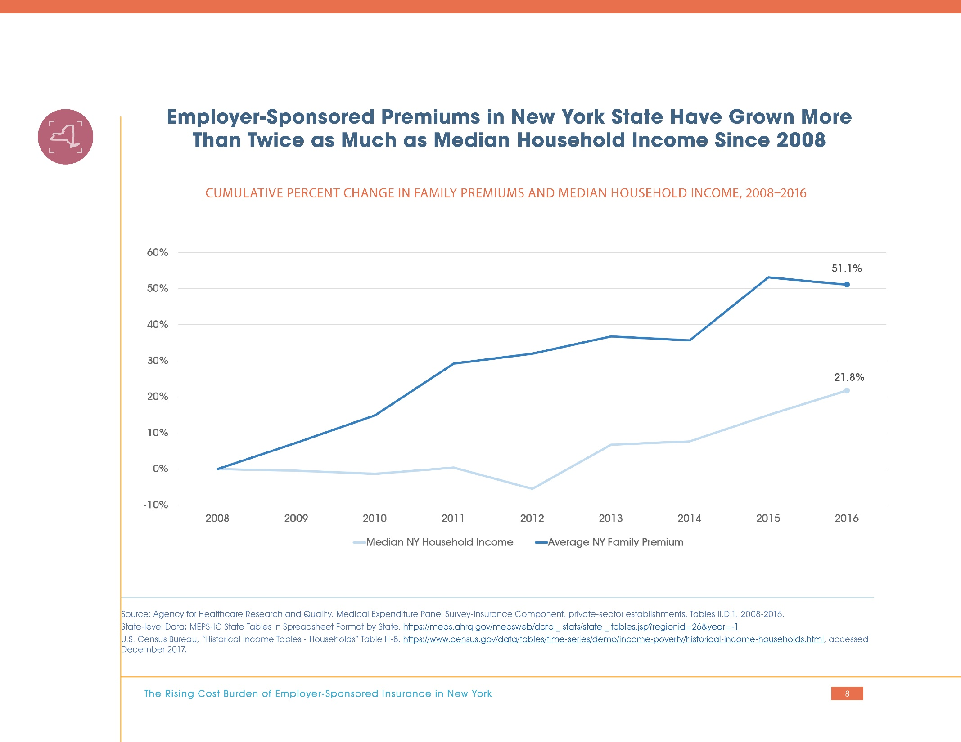
Notes:
Source: Agency for Healthcare Research and Quality, Medical Expenditure Panel Survey-Insurance Component, private-sector establishments, Tables II.D.1, 2008-2016.
State-level Data: MEPS-IC State Tables in Spreadsheet Format by State. https://meps.ahrq.gov/mepsweb/data _ stats/state _ tables.jsp?regionid=26&year=-1
U.S. Census Bureau, “Historical Income Tables - Households” Table H-8, https://www.census.gov/data/tables/time-series/demo/income-poverty/historical-income-households.html, accessed
December 2017.

Slide 9
Notes:
Note: Weighted averages and contributions are calculated using the percent of employees with an employer-sponsored plan who received single, employee-plus-one, or family coverage.
Source: Agency for Healthcare Research and Quality, Medical Expenditure Panel Survey-Insurance Component, private-sector establishments, Tables I.C.3, I.D.3, I.E.3, 2016,
National-level Data: https://meps.ahrq.gov/mepsweb/data _ stats/quick _ tables _ results.jsp?component=2&subcomponent=1&year=-1&tableSeries=1&tableSubSeries=CDE&searchText=&s
earchMethod=1&Action=Search;
State-level Data: MEPS-IC State Tables in Spreadsheet Format by State, Tables II.C.3, II.D.3, II.E.3, 2016. https://meps.ahrq.gov/mepsweb/data _ stats/state _ tables.jsp?regionid=26&year=-1

Slide 10
Notes:
Note: Weighted averages and contributions are calculated using the percent of employees with an employer-sponsored plan who received single, employee-plus-one, or family coverage.
Source: Agency for Healthcare Research and Quality, Medical Expenditure Panel Survey-Insurance Component, private-sector establishments, Tables I.C.3, I.D.3, I.E.3, 2008-2016
National-level Data: https://meps.ahrq.gov/mepsweb/data _ stats/quick _ tables _ results.jsp?component=2&subcomponent=1&year=-1&tableSeries=1&tableSubSeries=CDE&searchText=&s
earchMethod=1&Action=Search;
State-level Data: MEPS-IC State Tables in Spreadsheet Format by State, Tables II.C.3, II.D.3, II.E.3, 2008-2016. https://meps.ahrq.gov/mepsweb/data _ stats/state _ tables.
jsp?regionid=26&year=-1

Slide 11
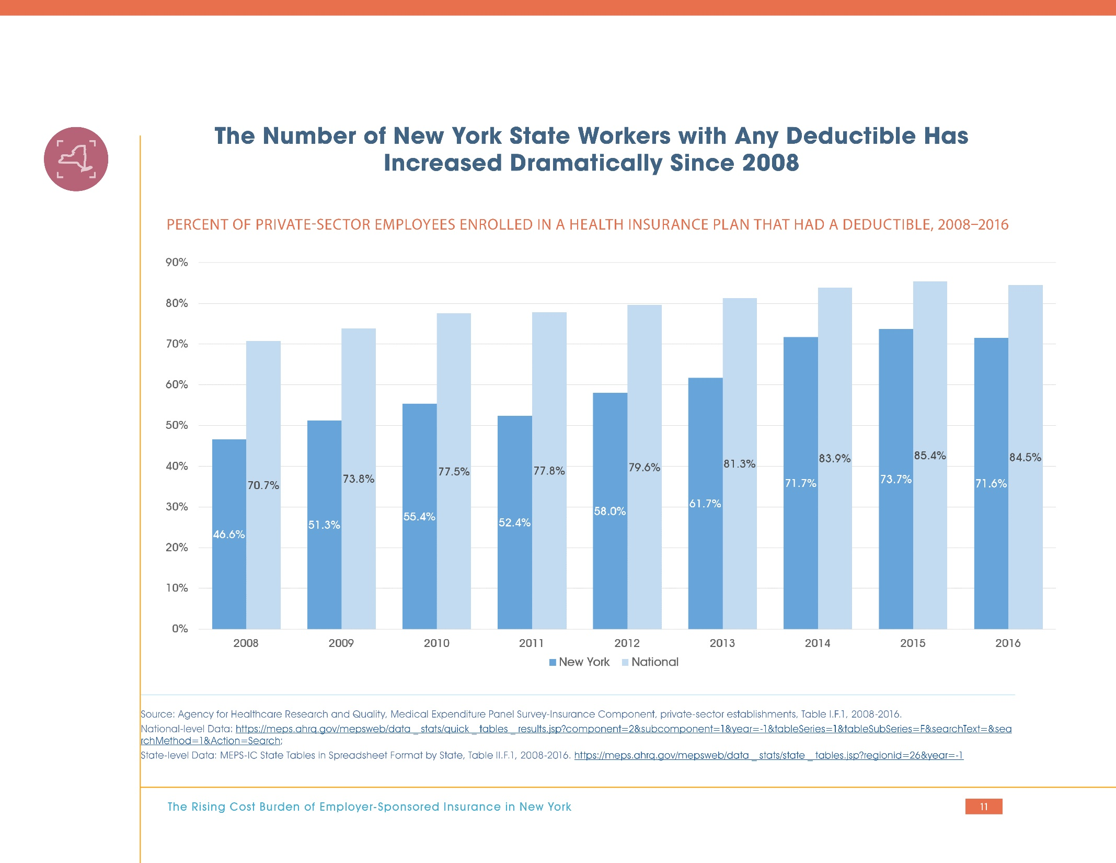
Notes:
Source: Agency for Healthcare Research and Quality, Medical Expenditure Panel Survey-Insurance Component, private-sector establishments, Table I.F.1, 2008-2016.
National-level Data: https://meps.ahrq.gov/mepsweb/data _ stats/quick _ tables _ results.jsp?component=2&subcomponent=1&year=-1&tableSeries=1&tableSubSeries=F&searchText=&sea
rchMethod=1&Action=Search;
State-level Data: MEPS-IC State Tables in Spreadsheet Format by State, Table II.F.1, 2008-2016. https://meps.ahrq.gov/mepsweb/data _ stats/state _ tables.jsp?regionid=26&year=-1

Slide 12
Notes:
Source: Agency for Healthcare Research and Quality, Medical Expenditure Panel Survey-Insurance Component, private-sector establishments, Tables I.F.2, I.F.3, 2008-2016.
National-level Data: https://meps.ahrq.gov/mepsweb/data _ stats/quick _ tables _ results.jsp?component=2&subcomponent=1&year=-1&tableSeries=1&tableSubSeries=F&searchText=&sea
rchMethod=1&Action=Search;
State-level Data: MEPS-IC State Tables in Spreadsheet Format by State, Tables II.F.2, II.F.3, 2008-2016. https://meps.ahrq.gov/mepsweb/data _ stats/state _ tables.jsp?regionid=26&year=-1

Slide 13
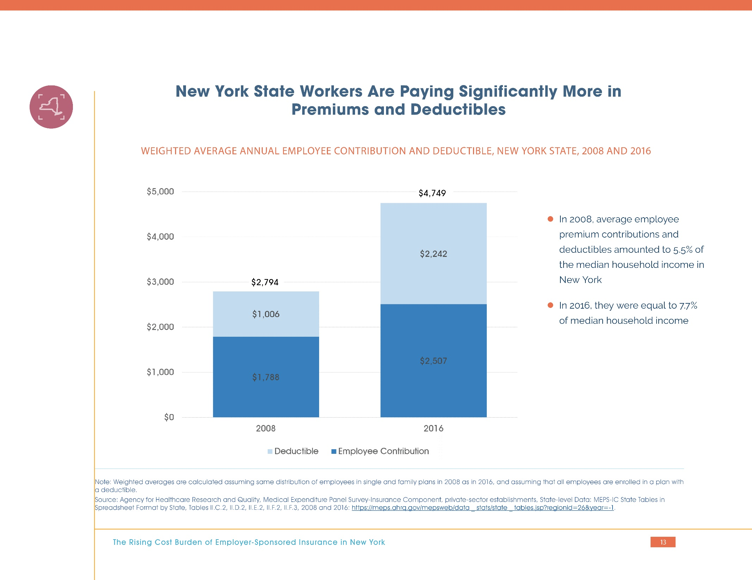
Notes:
Note: Weighted averages are calculated assuming same distribution of employees in single and family plans in 2008 as in 2016, and assuming that all employees are enrolled in a plan with
a deductible.
Source: Agency for Healthcare Research and Quality, Medical Expenditure Panel Survey-Insurance Component, private-sector establishments, State-level Data: MEPS-IC State Tables in
Spreadsheet Format by State, Tables II.C.2, II.D.2, II.E.2, II.F.2, II.F.3, 2008 and 2016: https://meps.ahrq.gov/mepsweb/data _ stats/state _ tables.jsp?regionid=26&year=-1.

Slide 15
Notes:
More information about the MEPS-IC, including sample design, data collection, and response
rates, can be found at: https://meps.ahrq.gov/survey_comp/Insurance.jsp.
For more information on the CPS-ASEC supplement methods, see https://www2.census.gov/
programs-surveys/cps/techdocs/cpsmar17.pdf.

